Slide 1
grid2demand: an open-source package to generate zone-to-zone travel demand
Output
Processing
Inputs
(bf-processing
Inputs
(sources)
Data Sources
Production
/Attraction Demand
Gravity Model
(Auto, Bike, Pedestrian)
Node
Node
osm2gmns
Must include zone_id for activity nodes
Zone from Grid or from TAZ
census blocks
Zone
TAZs from agencies
Optional
Zone-to-Zone
(OD Demand)
POI
POI
osm2gmns
Agent List
trip rate file
Package Core Engine

Slide 2
Current Input Modes Based on Our Meeting (Pls edit the PPT if I misunderstand)

Slide 3
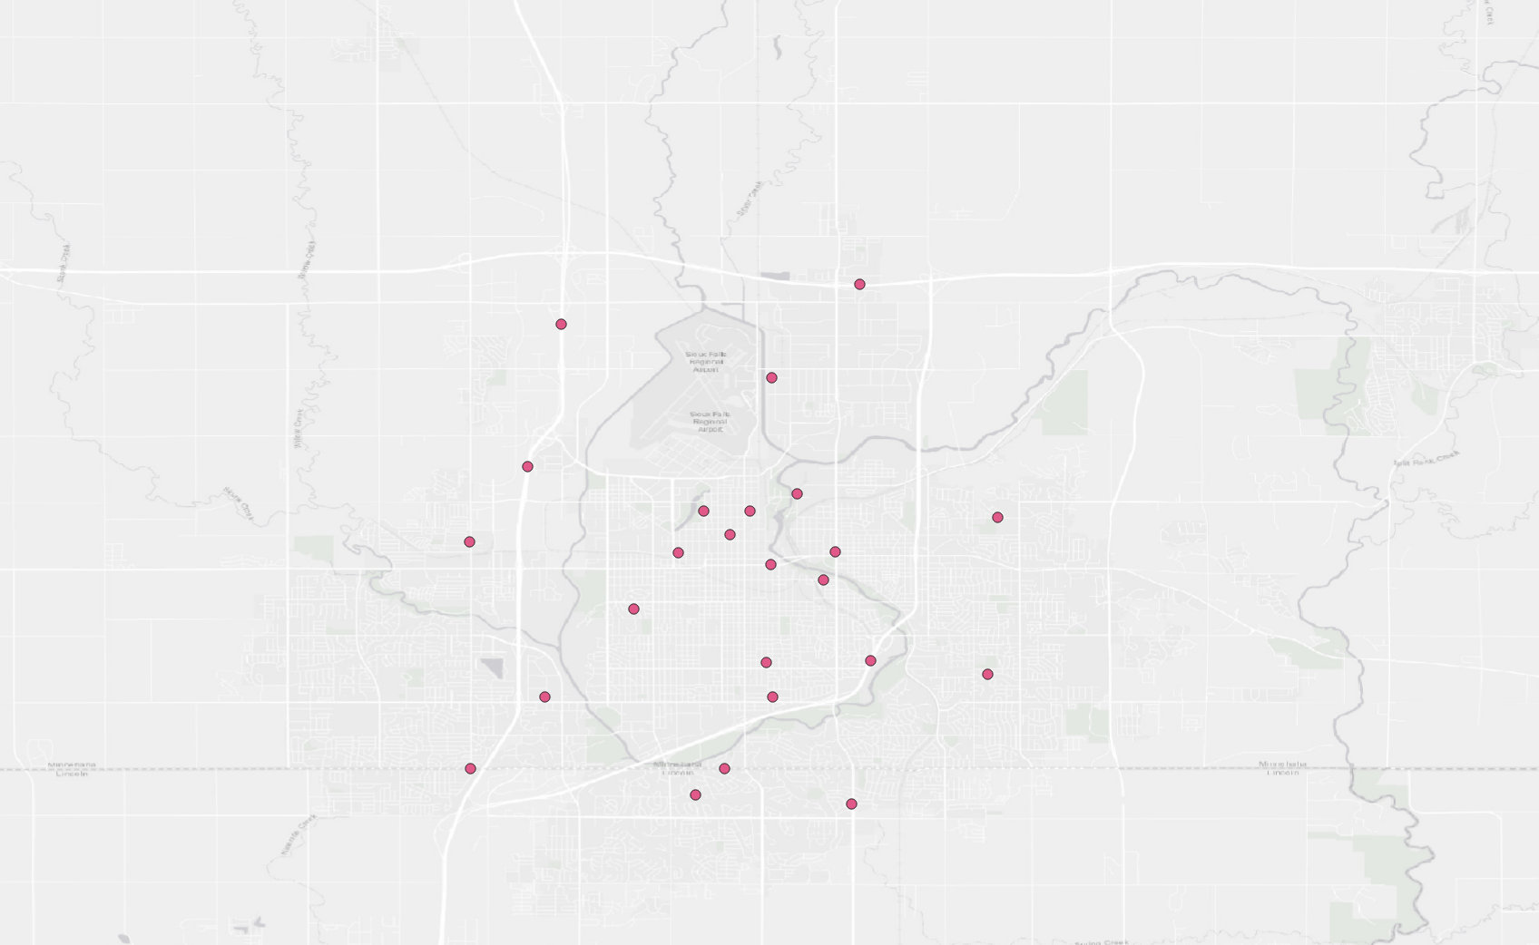
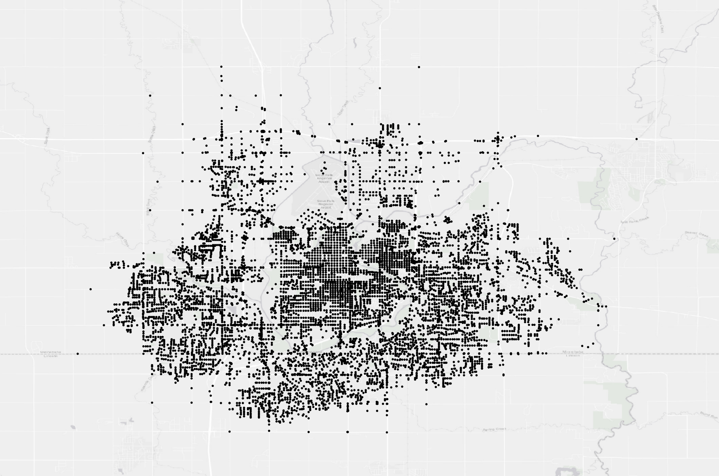
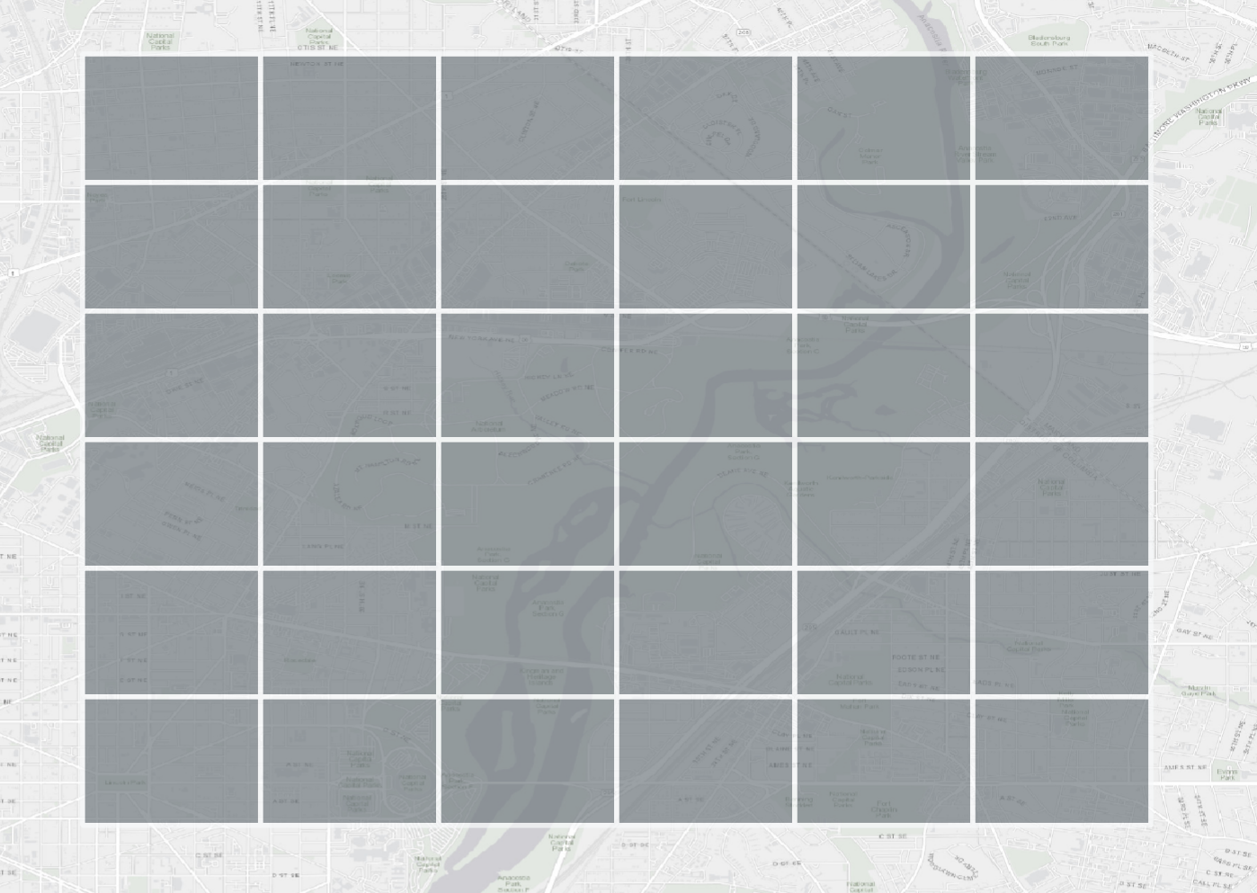
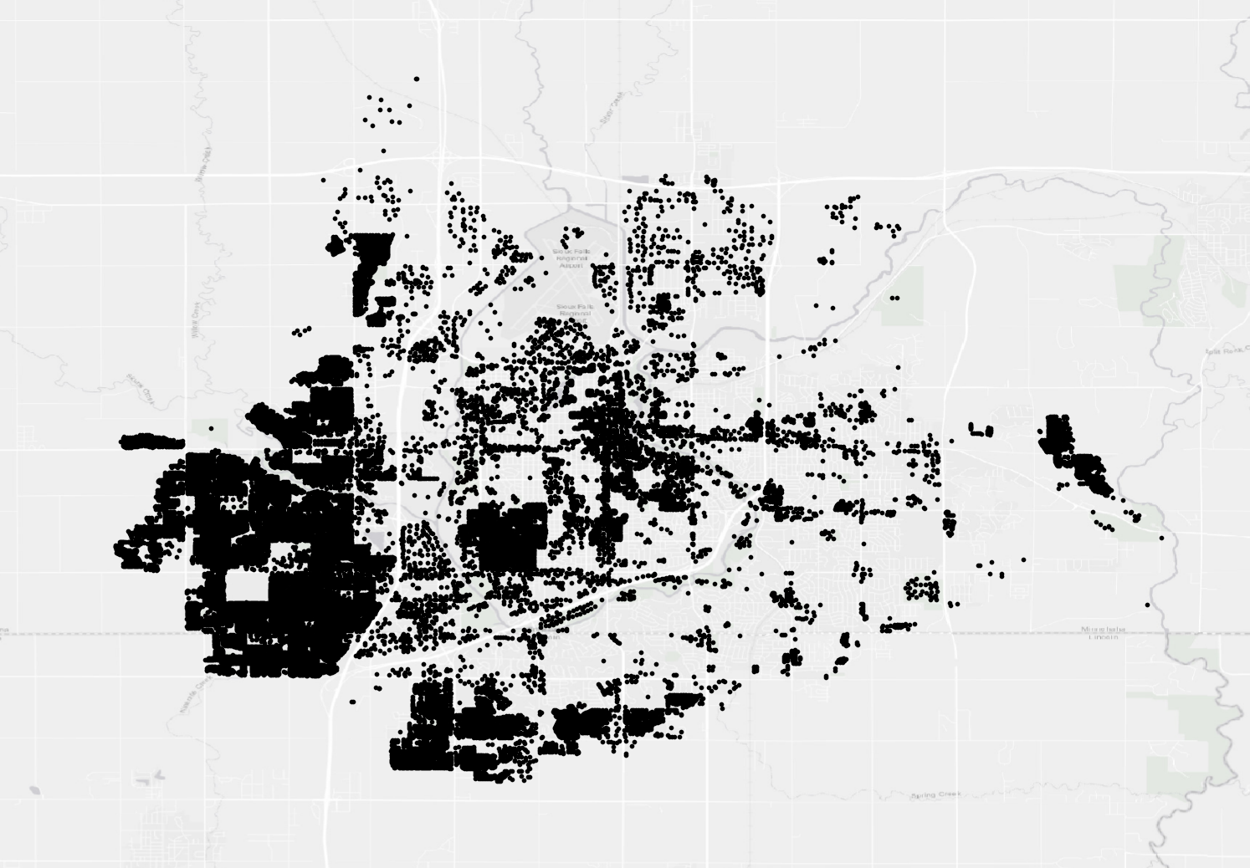
grid2demand: a tool to generate zone-to-zone travel demand
Input mode 1: Without external zone files (use zone_id in node as activity nodes): Inputs are node and poi
Output
Processing
Inputs
(bf-processing
Inputs
(sources)
Extract activity nodes from
Node with zone_id content
(Activity nodes)
Production
/Attraction Demand
Gravity Model
Node
Node
Create Grids from nodes
If activity nodes (zone_id) in node.csv is None, What should we do?
Stop the program!
Grid Zone
Zone-to-Zone
(OD Demand)
POI
POI
Agent List
Package Core Engine

Slide 4
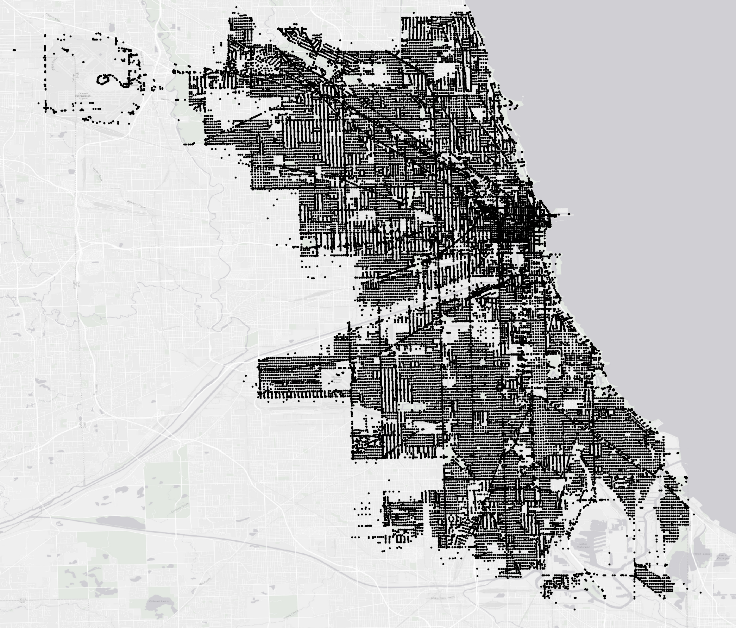
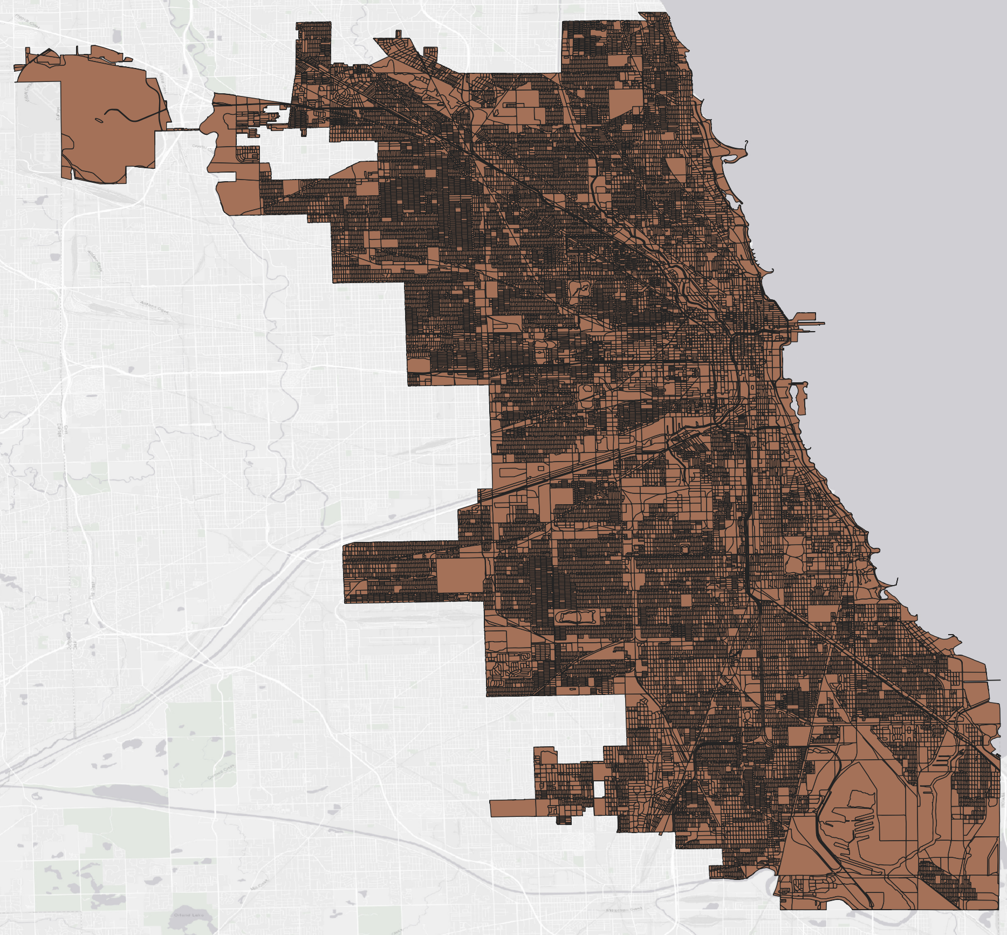
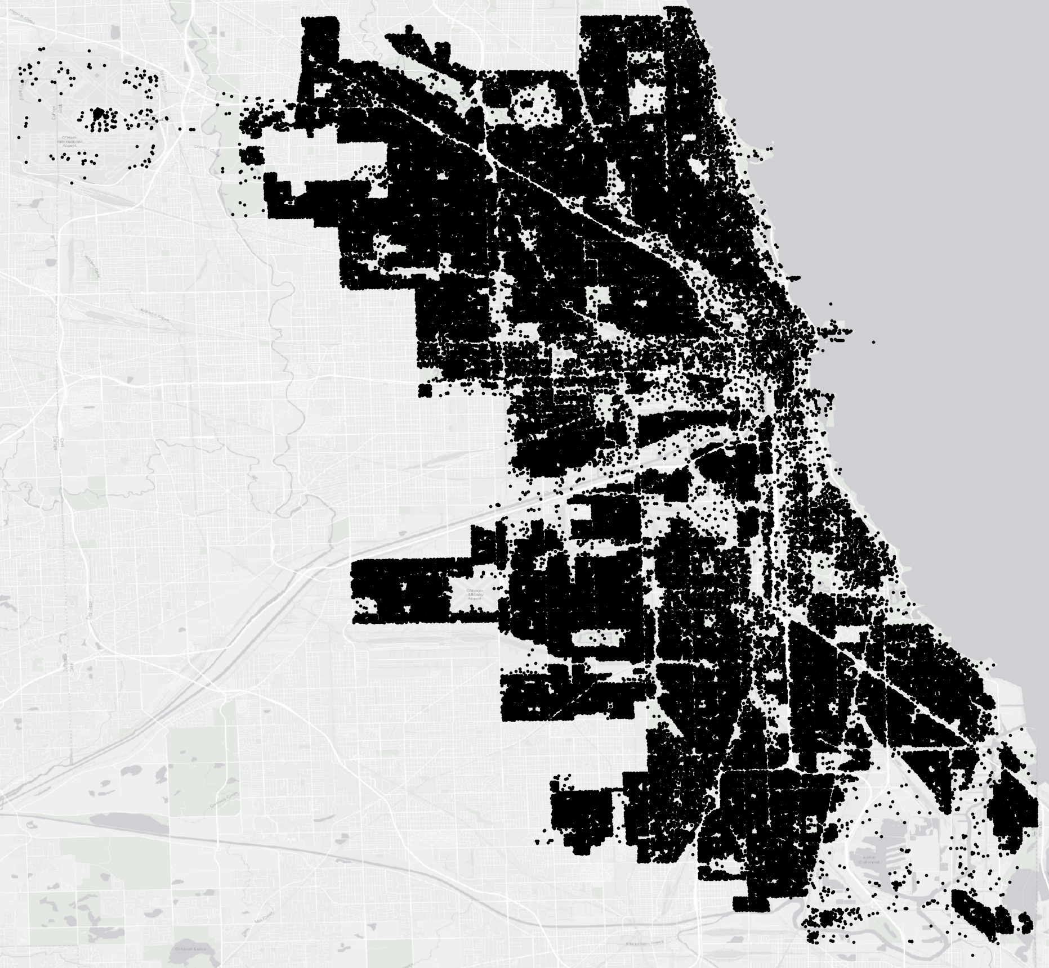
grid2demand: a tool to generate zone-to-zone travel demand
Input mode 2: with external zone file: (use external zones from TAZs): Inputs are node, zone and poi
Output
Processing
Inputs
(bf-processing
Inputs
(sources)
Production
/Attraction Demand
Gravity Model
Node
Node.csv
TAZ Zone
TAZ coded in Zone.csv
census blocks
Zone-to-Zone
(OD Demand)
POI
POI.csv
Agent List
Package Core Engine

Slide 5
Assumptions and Problem Statement
Initial Zone Assignment: In the Chicago dataset example, an initial zone ID for each node is derived from OpenStreetMap (OSM) using the osm2gmns package. The zone ID is initially the same as the node ID.
Activity Nodes: Out of 30K nodes in the Chicago dataset, 3K activity nodes are identified, typically situated on boundary points of primary and secondary streets or interfacing points. Zone IDs assigned by grid2demand are only for activity nodes.
Two Zone System Setup Options:
Grid Setup: A 10x10 grid is created for the 3K activity nodes. Each activity node assigned to one grid cell.
External TAZ Setup: Alternatively, 40K census blocks (external TAZ zones) are used, refining zone structures and improving demand pattern capture. Each activity node assigned to external TAZ zone id.
POI-Demand Zone Assignment: The demand for each zone is calculated using proximity-based assignment of points of interest (POIs) within the grid, and sampling (e.g., processing 10% of POIs) optimizes performance. There are about 80K POIs in the Chicago dataset.
Gravity Model for Demand Calculation: A gravity model is used to estimate demand between zones
1) The production and attraction estimation model should utilize a matrix or vector format to streamline calculations.
2) For large datasets (e.g., 1M+ POIs), sampling should be implemented, such as using a 10% subset for processing, avoiding the need to scan all POIs.

Slide 6
Previous Input Modes (grid2demand<= v0.6.4) (I keep these modes for the future tracking)

Slide 7
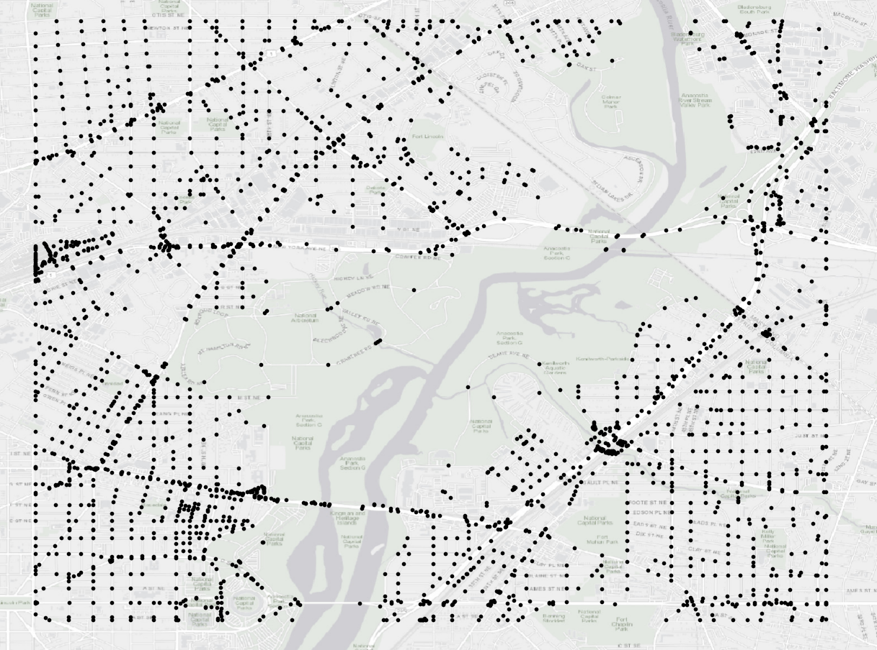
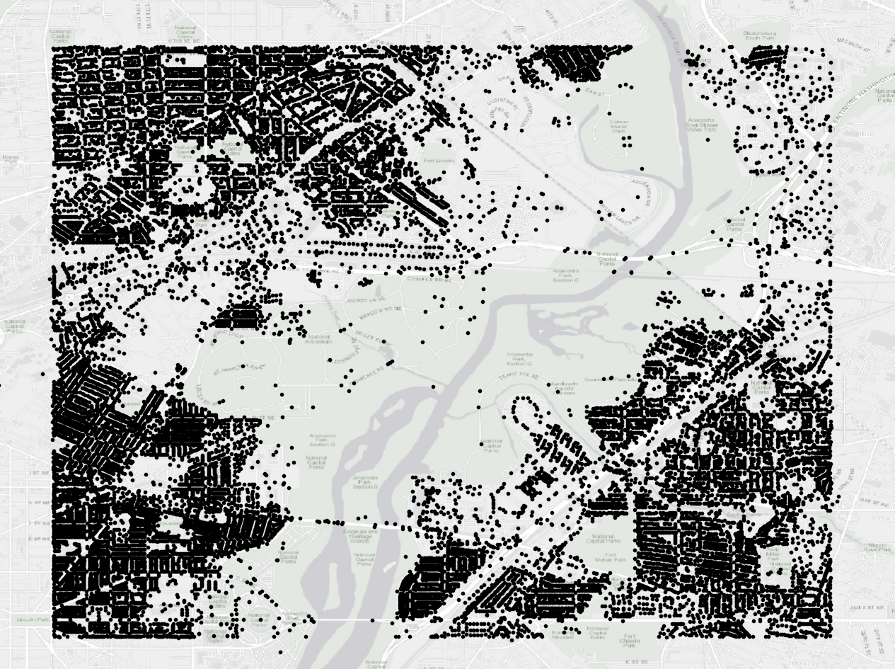
grid2demand: a tool to generate zone-to-zone travel demand
Mode 1 (create grid zones): Inputs are node and poi
Output
Processing
Inputs
(bf-processing
Inputs
(sources)
Demand
Gravity Model
Node
Node
Without zone_id
Create Grids from Node
Zone
Zone-to-Zone
(OD Demand)
POI
POI
Agent
Package Core Engine

Slide 8
grid2demand: a tool to generate zone-to-zone travel demand
Mode 2 (use zone_id in node as zone): Inputs are node and poi
Output
Processing
Inputs
(bf-processing
Inputs
(sources)
Demand
Gravity Model
Node
Node
With zone_id
Extract zone_id from node as zone
for zone-zone demands
Zone
Zone-to-Zone
(OD Demand)
POI
POI
Agent
Package Core Engine

Slide 9
grid2demand: a tool to generate zone-to-zone travel demand
Mode 3 (use external zones from TAZs): Inputs are node and poi
Output
Processing
Inputs
(bf-processing
Inputs
(sources)
Demand
Gravity Model
Node
Node
Zone
Zone
census blocks
Zone-to-Zone
(OD Demand)
POI
POI
Agent
Package Core Engine

